Slide 1
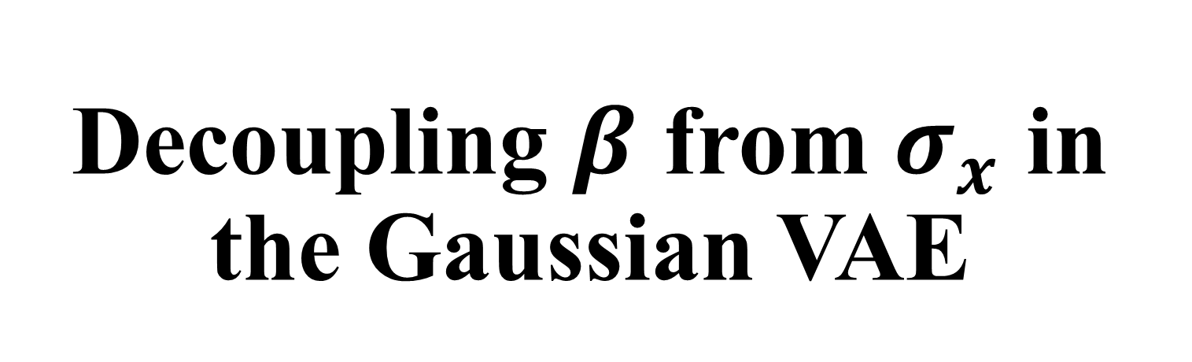
Decoupling $β$ from $σ_{x}$ in the Gaussian VAE
Presenter: Kim Seung Hwan (overnap@khu.ac.kr)

Slide 2
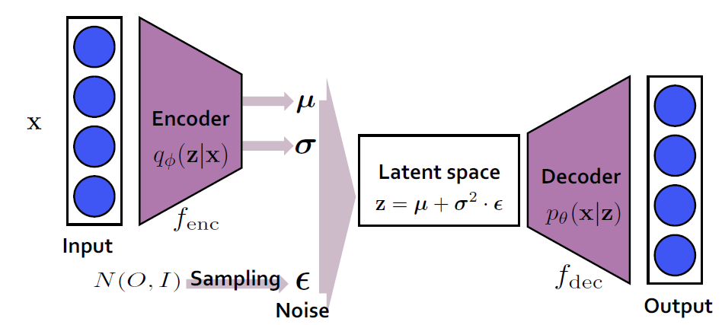

(Gaussian) Variational Autoencoder
Deep Maximum Likelihood Model
Decoder $p_{θ}(x|z)$ and a $q_{φ}\left(z | x\right)$ for a Data $x$ and its latent representation $z$
$p_{θ}\left(x | z\right)\sim N(μ_{x}\left(z\right), σ_{x}^{2}\left(z\right))$, $q_{φ}\left(z | x\right)\sim N(μ_{z}\left(x\right), σ_{z}^{2}\left(x\right))$

Slide 3

Implementation of Gaussian
$p_{θ}\left(x | z\right)\sim N(μ_{x}\left(z\right), σ_{x}^{2}\left(z\right))$, $q_{φ}\left(z | x\right)\sim N(μ_{z}\left(x\right), σ_{z}^{2}\left(x\right))$
This means that they follow the distributions
No need to be explicitly sampled!

Slide 4

Implementation of Gaussian (contd.)
Typical VAEs are implemented with the explicit encoder and implicit decoder
Specifically, $p_{θ}\left(x | z\right)\sim N\left(μ_{x}\left(z\right), σ_{x}^{2}\left(z\right)I\right)$ i.e. same variance on all channels
And $q_{φ}\left(z | x\right)\sim N(μ_{z}\left(x\right), diag(σ_{z}^{2}\left(x\right)))$ i.e. diagonal covariance

Slide 5
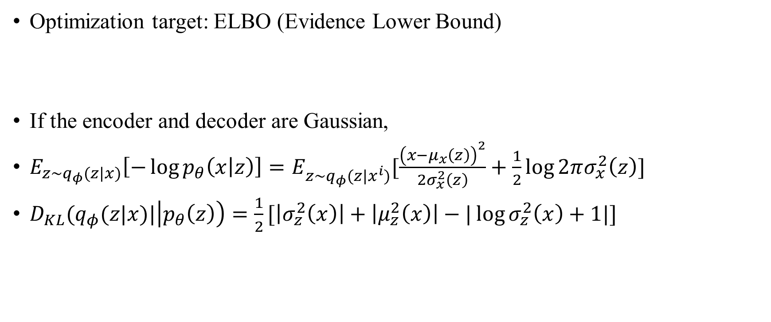
Evidential Lower Bound
Optimization target: ELBO (Evidence Lower Bound)
If the encoder and decoder are Gaussian,
$E_{z\sim q_{φ}(z|x)}\left[−\log{p_{θ}\left(x | z\right)}\right]=E_{z\sim q_{φ}(z|x^{i})}[\frac{{\left(x−μ_{x}\left(z\right)\right)}^{2}}{{2σ}_{x}^{2}\left(z\right)}+\frac{1}{2}\log{2πσ_{x}^{2}\left(z\right)}]$
$D_{KL}(q_{φ}(z|x)|\left|p_{θ}\left(z\right)\right)=\frac{1}{2}[\left|σ_{z}^{2}\left(x\right)\right|+\left|μ_{z}^{2}\left(x\right)\right|−|\log{σ_{z}^{2}\left(x\right)}+1|]$

Slide 6
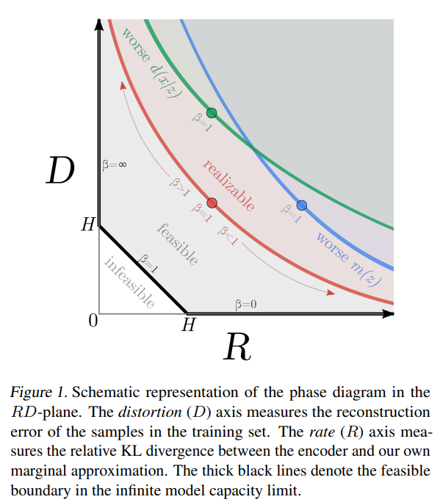
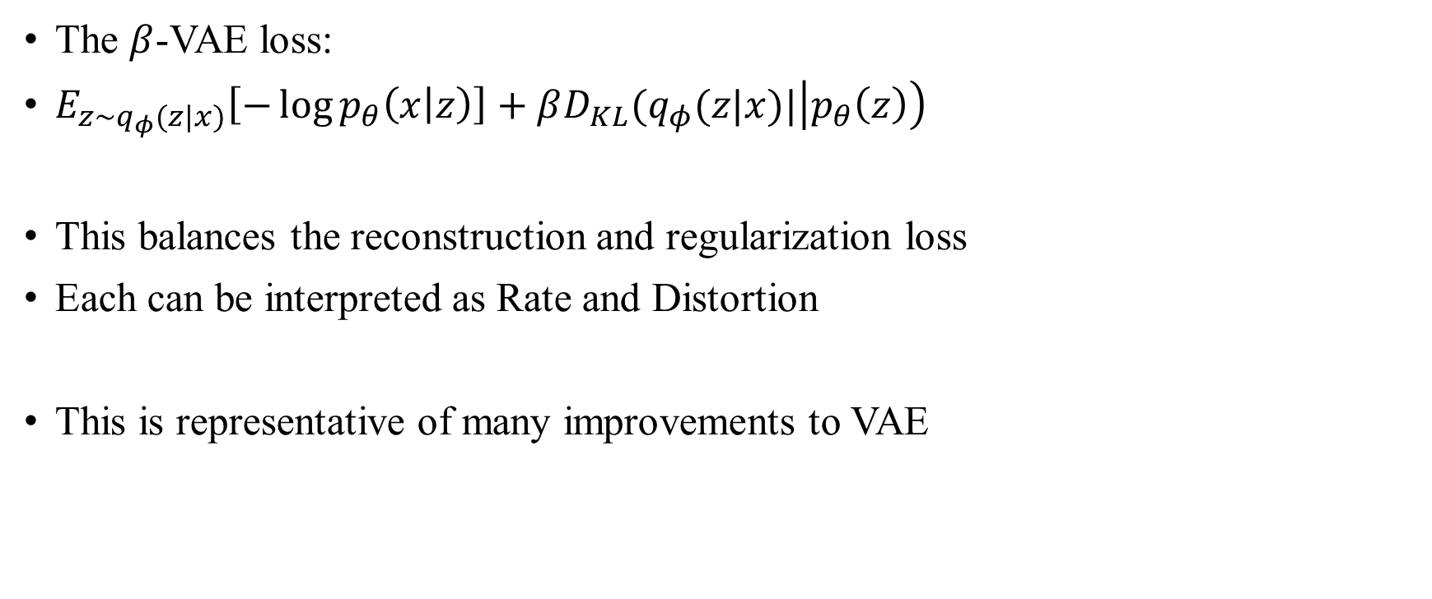
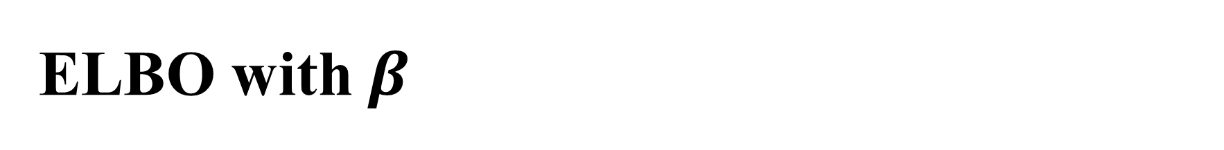
ELBO with $β$
The $β$-VAE loss:
$E_{z\sim q_{φ}(z|x)}\left[−\log{p_{θ}\left(x | z\right)}\right]+βD_{KL}(q_{φ}(z|x)|\left|p_{θ}\left(z\right)\right)$
This balances the reconstruction and regularization loss
Each can be interpreted as Rate and Distortion
This is representative of many improvements to VAE
Reconstruction loss = Distortion
Regularization loss = Rate

Slide 7
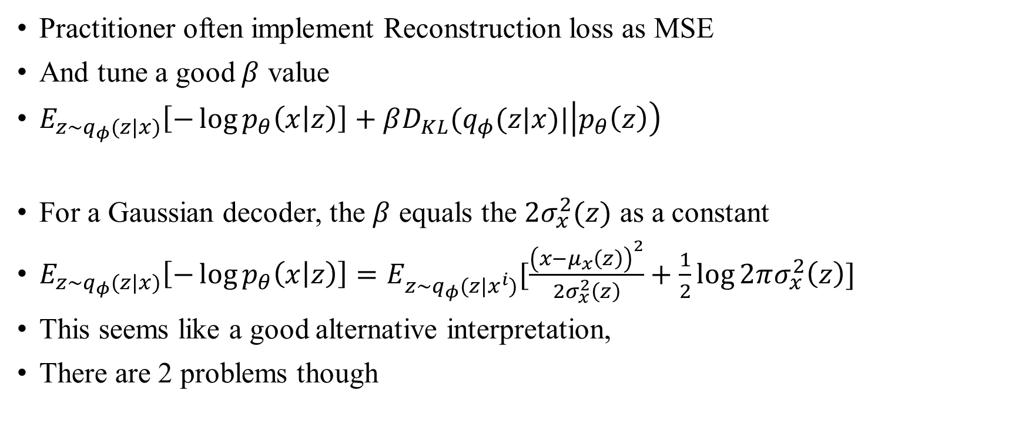
The Pitfall When Implementing ELBO
Practitioner often implement Reconstruction loss as MSE
And tune a good $β$ value
$E_{z\sim q_{φ}(z|x)}\left[−\log{p_{θ}\left(x | z\right)}\right]+βD_{KL}(q_{φ}(z|x)|\left|p_{θ}\left(z\right)\right)$
For a Gaussian decoder, the $β$ equals the ${2σ}_{x}^{2}(z)$ as a constant
$E_{z\sim q_{φ}(z|x)}\left[−\log{p_{θ}\left(x | z\right)}\right]=E_{z\sim q_{φ}(z|x^{i})}[\frac{{\left(x−μ_{x}\left(z\right)\right)}^{2}}{{2σ}_{x}^{2}\left(z\right)}+\frac{1}{2}\log{2πσ_{x}^{2}\left(z\right)}]$
This seems like a good alternative interpretation,
There are 2 problems though
Reconstruction loss = Distortion
Regularization loss = Rate

Slide 8
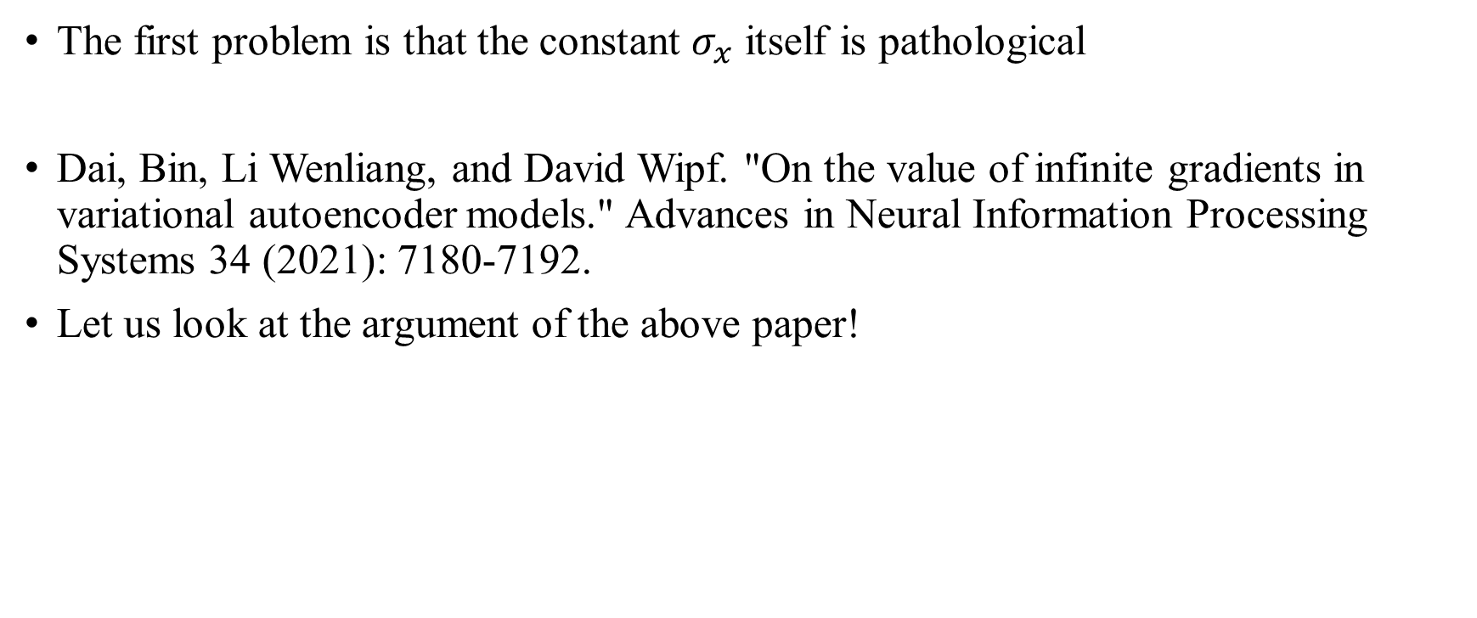
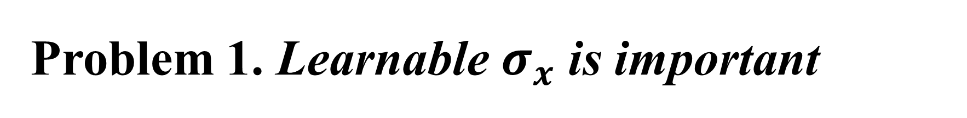
Problem 1. Learnable $σ_{x}$ is important
The first problem is that the constant $σ_{x}$ itself is pathological
Dai, Bin, Li Wenliang, and David Wipf. "On the value of infinite gradients in variational autoencoder models." Advances in Neural Information Processing Systems 34 (2021): 7180-7192.
Let us look at the argument of the above paper!

Slide 9
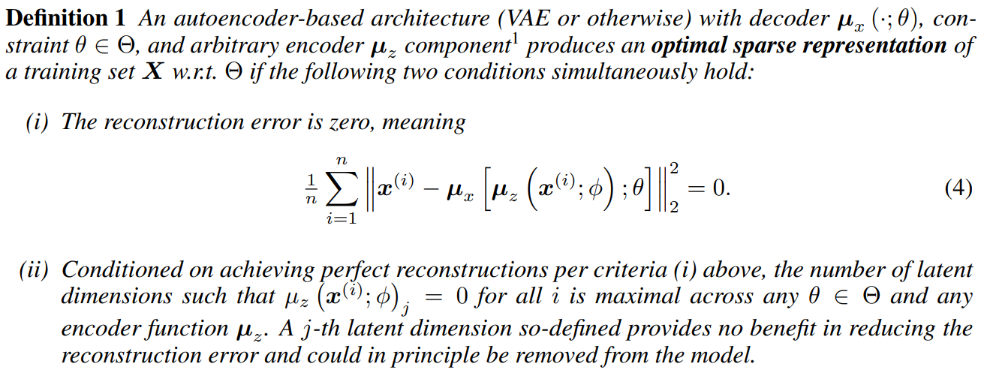
Optimal Sparse Representation
The minimum information that can represent the data manifold perfectly
In the words of the authors, “the most parsimonious latent representation”

Slide 10
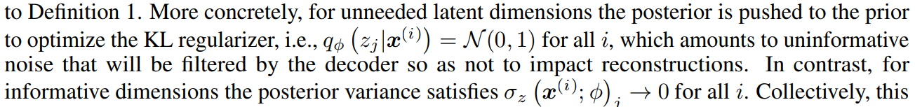

Why Mean?
Is it okay to consider only the mean (of the encoder and decoder?)
Dai, Bin, and David Wipf. "Diagnosing and Enhancing VAE Models." International Conference on Learning Representations. 2018.
$$γ=σ_{x}^{2}(z)$$
Estimated low-noise latent dimensions $≈$ Informative dimension
Power
Result

Slide 11
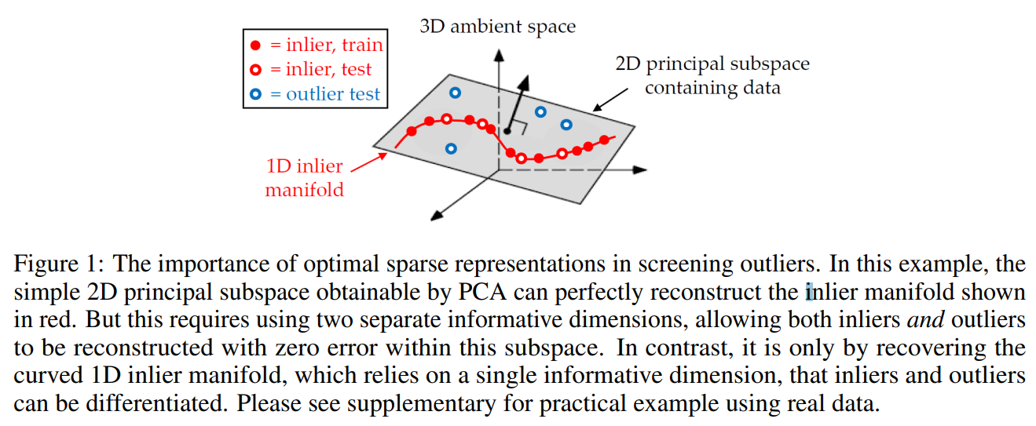
Why Sparse?
Why is sparsity necessary for downstream task e.g. generation?
The authors explain with an example of inlier-outlier
I am still confused; would not it be better to use all channels for generation?

Slide 12
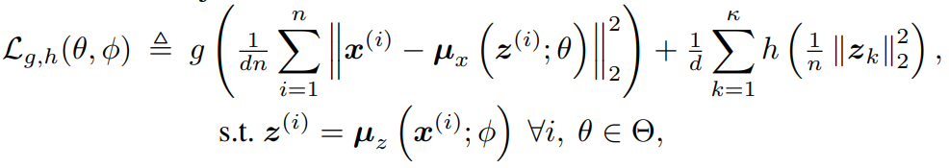
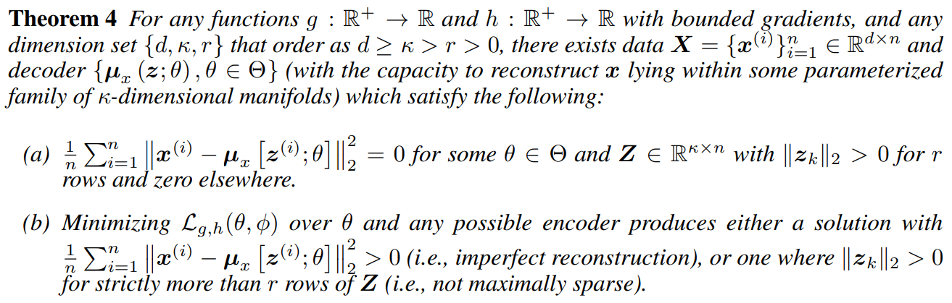

Infinite Gradient Is Integral
For generalized loss of an autoencoder-like model, (i.e. MSE + Regularizing-Z)
Minimizing the loss with bounded $g, h$ (which means a finite gradient)
Cannot produce perfect reconstruction or optimal sparsity

Slide 13
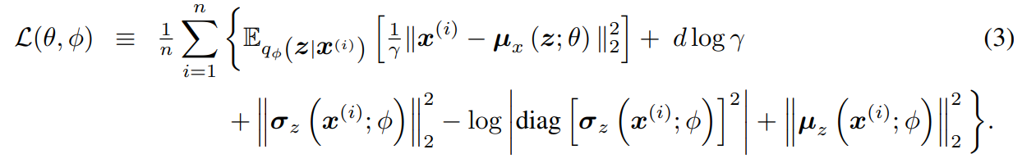

Infinite Gradient Is Integral (contd.)
An infinite gradient is thus a necessary condition (not a sufficient condition)
Even with other AEs, infinite gradient are essential e.g. AAE, WAE, DAE
The often-ignored decoder variance $σ_{x}^{2}\left(z\right)$ of VAEs is also essential!
Now let us look at it experimentally
Greens can be infinitely large or small
Reconstruction loss (Distortion)
Regularization loss (Rate)

Slide 14
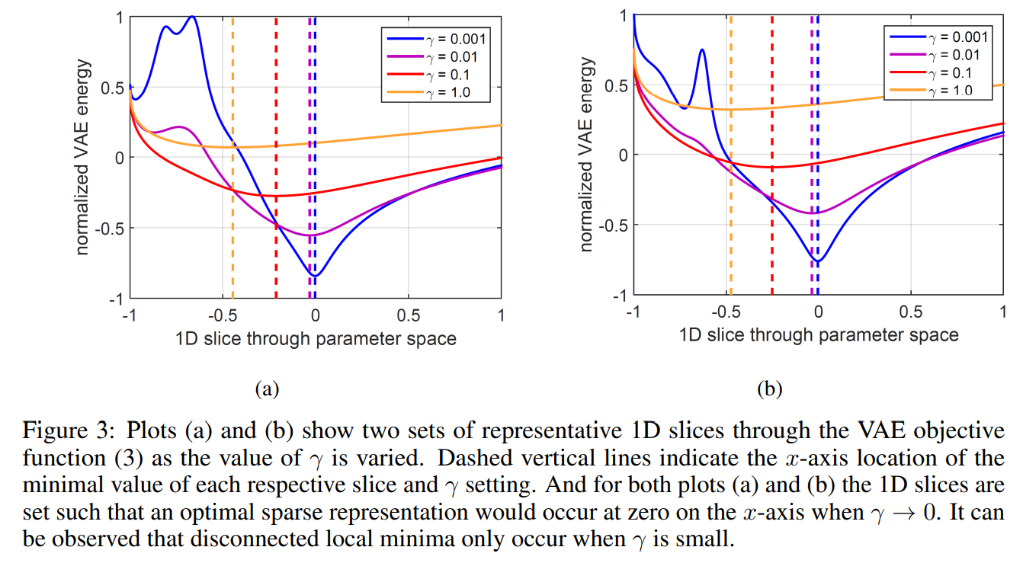
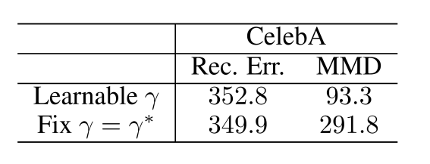

Visualization
A large $σ_{x}^{2}$ smooths the loss, and a small $σ_{x}^{2}$ reveals the exact optimal
So if one knows the optimal $σ_{x}^{2}$ ($≈0$) and fixes the $σ_{x}^{2}$ from the start,
One might get the bad result (note the constant $σ_{x}^{2}$ model $≈$ $β$-VAE)

Slide 15
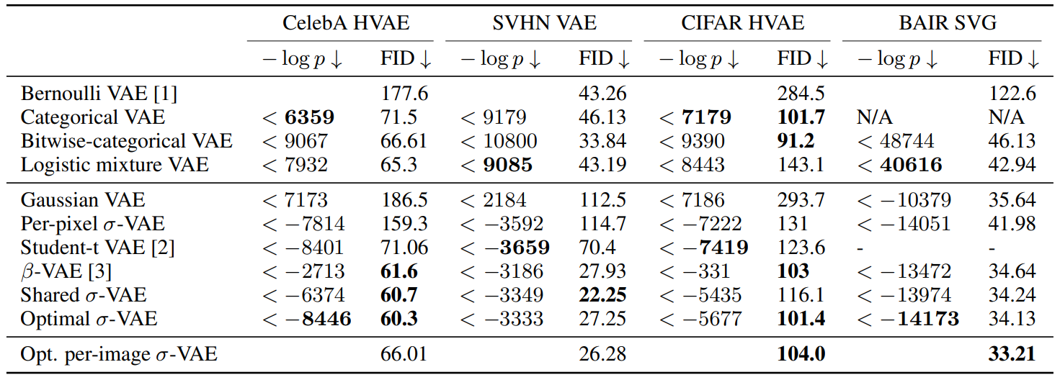
Calibrated Decoder
But the instability of the infinite gradient needs to be addressed!
Rybkin, Oleh, Kostas Daniilidis, and Sergey Levine. "Simple and effective VAE training with calibrated decoders." International Conference on Machine Learning. PMLR, 2021.

Slide 16
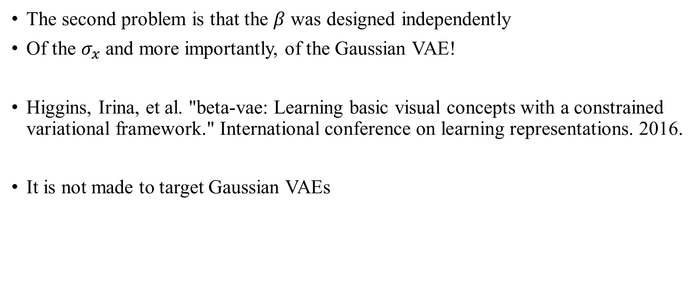
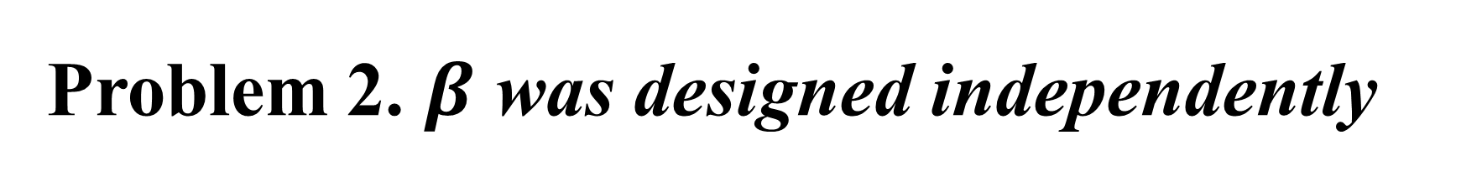
Problem 2. $β$ was designed independently
The second problem is that the $β$ was designed independently
Of the $σ_{x}$ and more importantly, of the Gaussian VAE!
Higgins, Irina, et al. "beta-vae: Learning basic visual concepts with a constrained variational framework." International conference on learning representations. 2016.
It is not made to target Gaussian VAEs

Slide 17
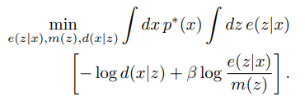
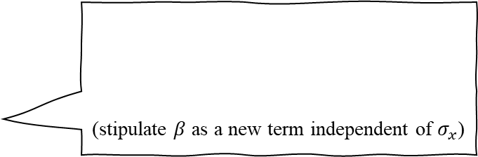
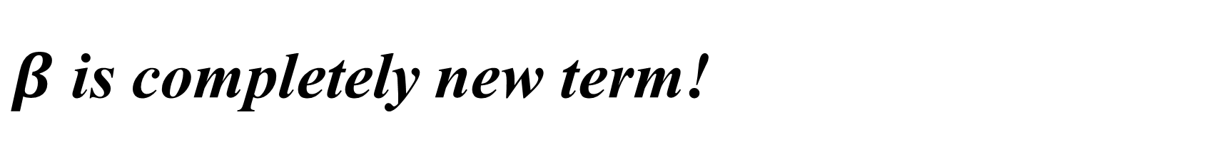
$β$ is completely new term!
(stipulate $β$ as a new term independent of $σ_{x}$)
Alemi, Alexander, et al. "Fixing a broken ELBO." International conference on machine learning. PMLR, 2018.
“Importantly, the Gaussian partition function for a Gaussian observation model (the last term on the RHS of Eq. (10)) prevents ELBO from deviating from the β-VAE’s objective with a β-weighted KL term while maintaining the benefits to representation learning when σ2 is small.
Lucas, James, et al. "Don't blame the elbo! a linear vae perspective on posterior collapse." Advances in Neural Information Processing Systems 32 (2019).
Burgess, Christopher P., et al. "Understanding disentangling in $\beta $-VAE." arXiv preprint arXiv:1804.03599 (2018).
(same as the first above)

Slide 18
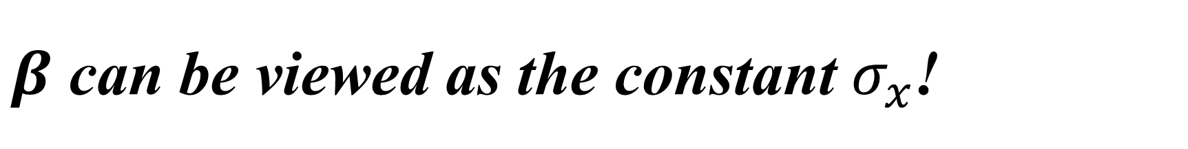
$β$ can be viewed as the constant $σ_{x}$!
“For Gaussian VAE models (which is our focus), this scale factor effectively makes no difference if a fixed decoder variance is adopted. In this situation, β can just be directly absorbed into γ, and the d log γ normalization factor from (3) can be viewed as an irrelevant constant.”
Dai, Bin, Li Wenliang, and David Wipf. "On the value of infinite gradients in variational autoencoder models." Advances in Neural Information Processing Systems 34 (2021): 7180-7192.
“The 𝛽-VAE objective is then equivalent to a 𝜎-VAE with a constant variance 𝜎^2=𝛽/2 (for a particular learning rate setting.)”
Rybkin, Oleh, Kostas Daniilidis, and Sergey Levine. "Simple and effective VAE training with calibrated decoders." International Conference on Machine Learning. PMLR, 2021.

Slide 19
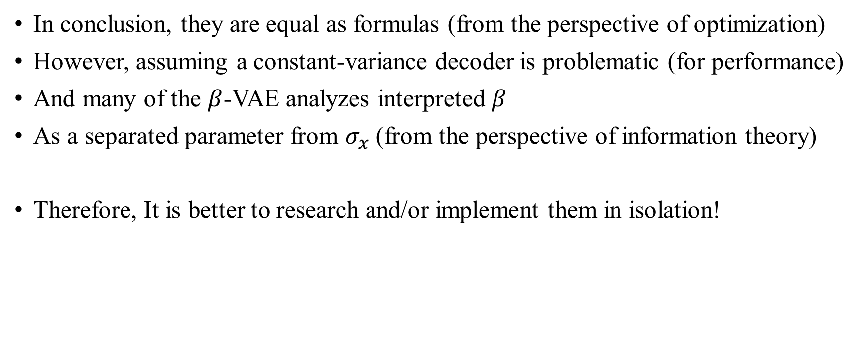
Conclusion
In conclusion, they are equal as formulas (from the perspective of optimization)
However, assuming a constant-variance decoder is problematic (for performance)
And many of the $β$-VAE analyzes interpreted $β$
As a separated parameter from $σ_{x}$ (from the perspective of information theory)
Therefore, It is better to research and/or implement them in isolation!

Slide 20
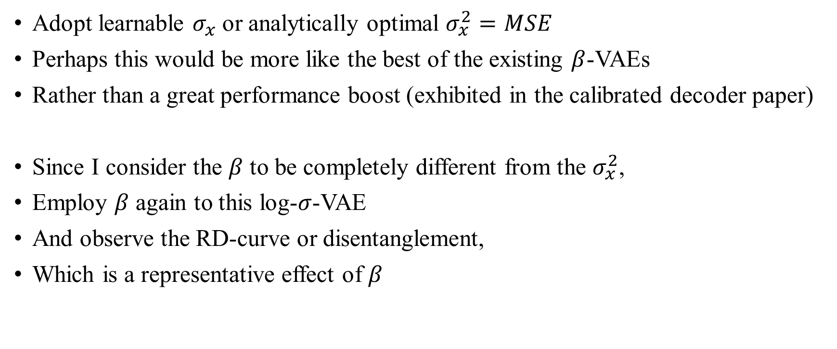
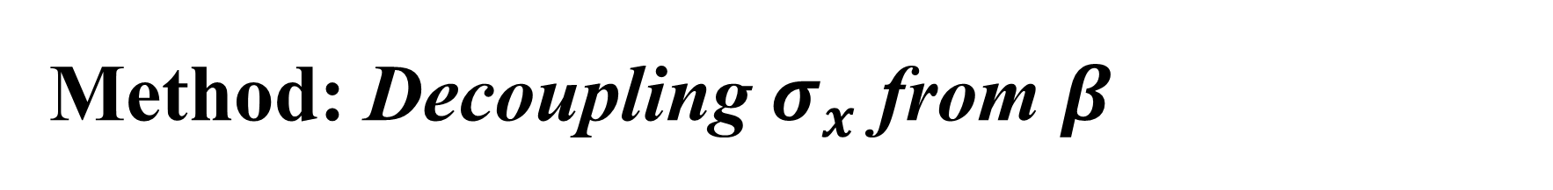
Method: Decoupling $σ_{x}$ from $β$
Adopt learnable $σ_{x}$ or analytically optimal $σ_{x}^{2}=MSE$
Perhaps this would be more like the best of the existing $β$-VAEs
Rather than a great performance boost (exhibited in the calibrated decoder paper)
Since I consider the $β$ to be completely different from the $σ_{x}^{2}$,
Employ $β$ again to this log-$σ$-VAE
And observe the RD-curve or disentanglement,
Which is a representative effect of $β$

Slide 21
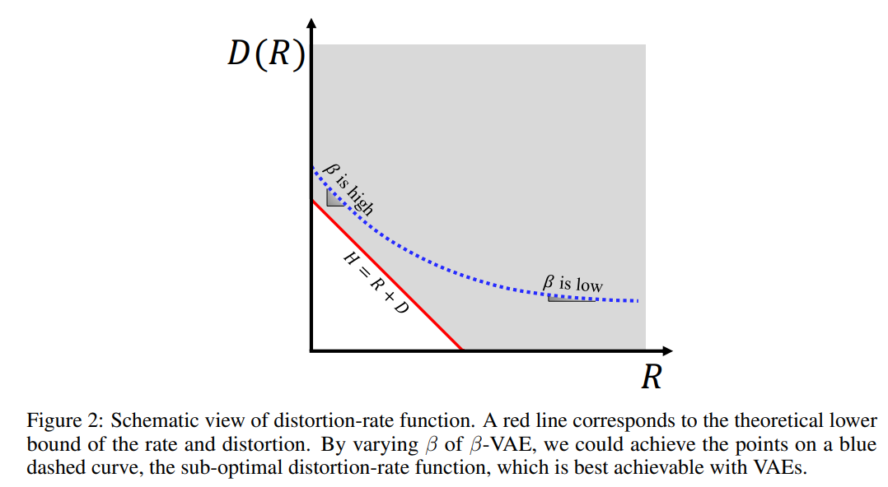
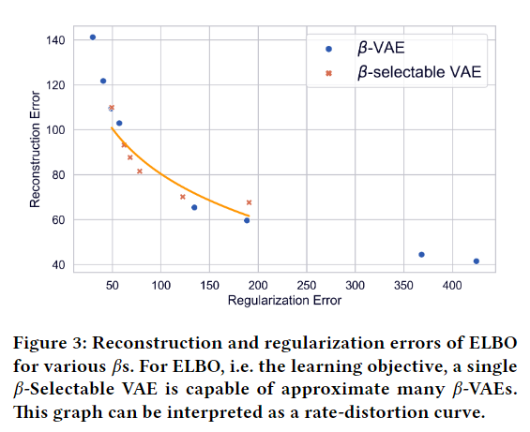
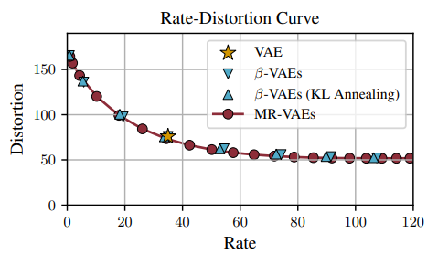
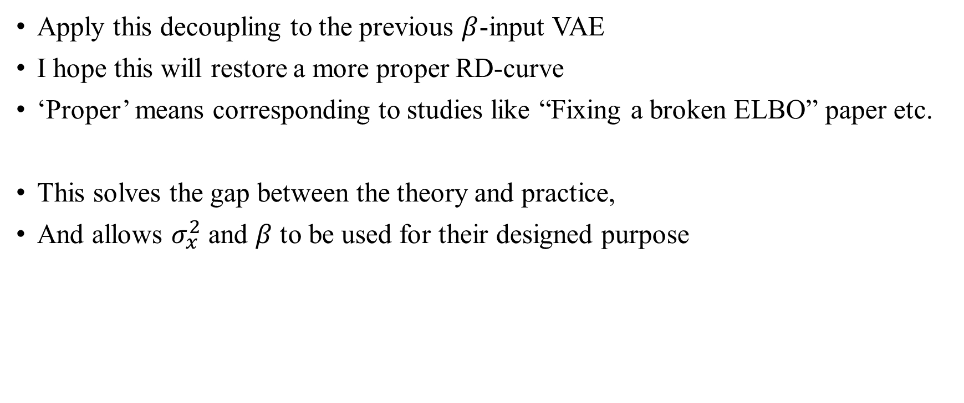
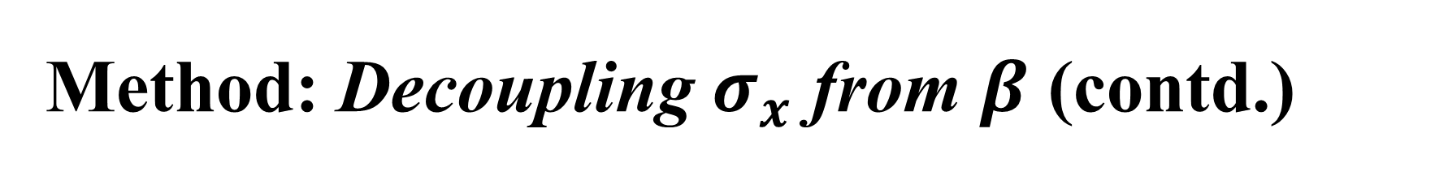
Method: Decoupling $σ_{x}$ from $β$ (contd.)
Apply this decoupling to the previous $β$-input VAE
I hope this will restore a more proper RD-curve
‘Proper’ means corresponding to studies like “Fixing a broken ELBO” paper etc.
This solves the gap between the theory and practice,
And allows $σ_{x}^{2}$ and $β$ to be used for their designed purpose

Slide 22
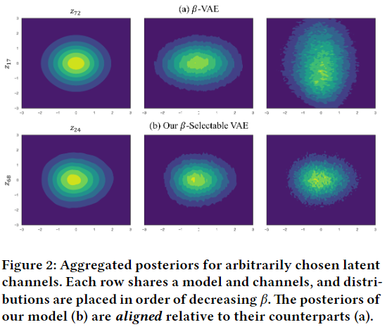
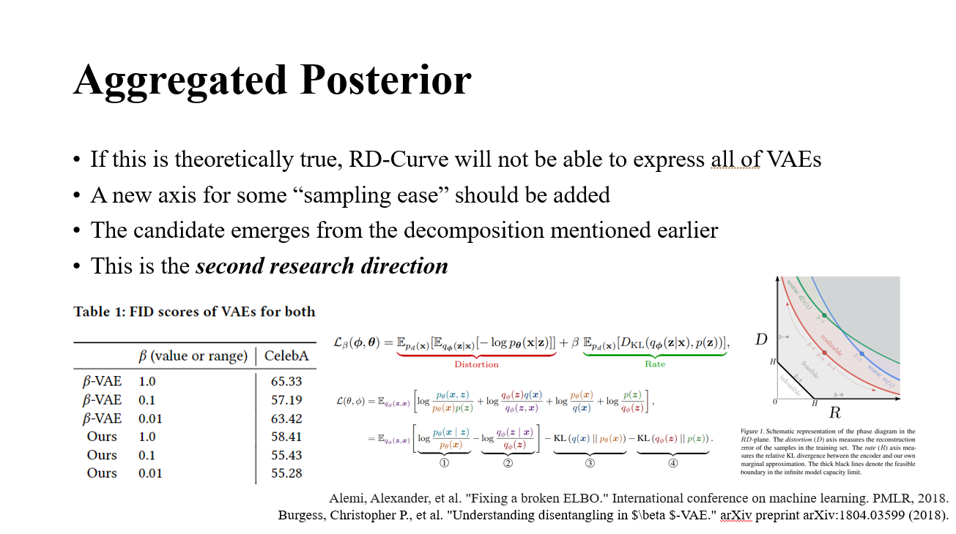
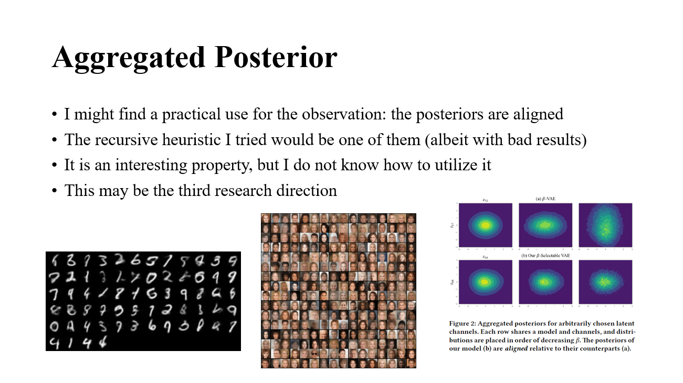

Additional Methods
1. Decompose $D_{KL}(q_{φ}(z|x)||p\left(z\right))$ (from second direction)
When strengthening the regularization term,
We do not want to suffer the performance penalty while taking advantage of good sampling
2. Make sampler (from third direction)
The posterior sampler of a VAE is often easily implemented as a second VAE
Can one $β$-input VAE perform complete sampling of other $β$-input VAE?

Slide 23
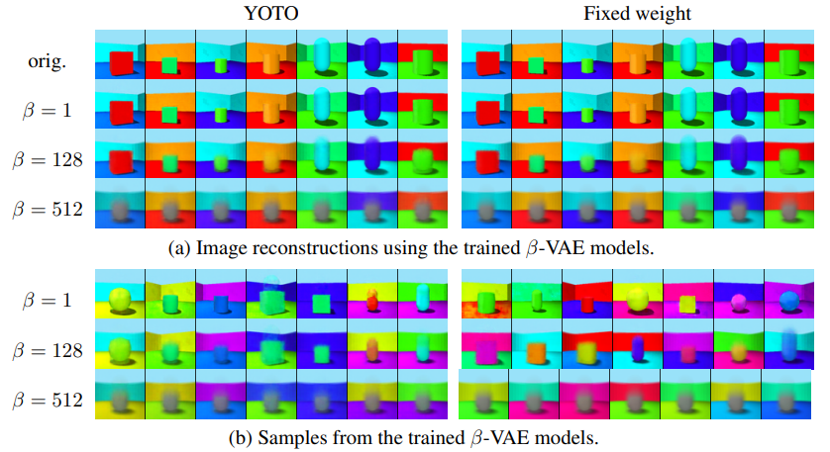
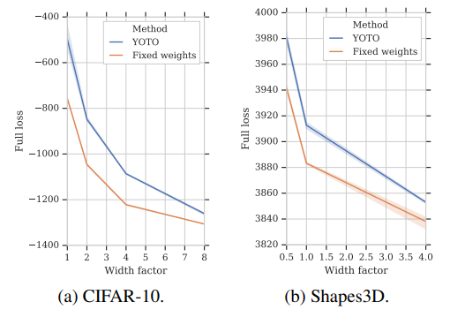

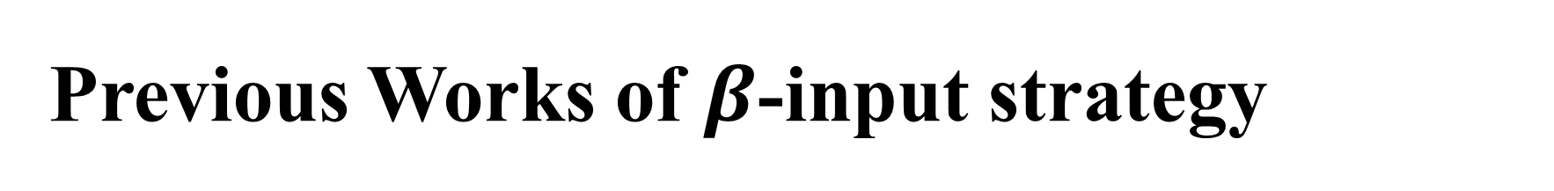
Previous Works of $β$-input strategy
1. YOTO: You Only Train Once
A naïve approach to approximating linear-weighted loss with one Neural Network
Possibly the first study to make VAE’s $β$ modifiable (input-able)
Dosovitskiy, Alexey, and Josip Djolonga. "You only train once: Loss-conditional training of deep networks." International conference on learning representations. 2019.

Slide 24
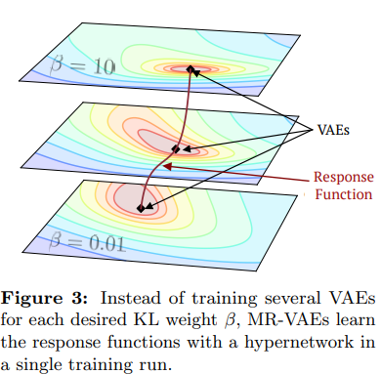
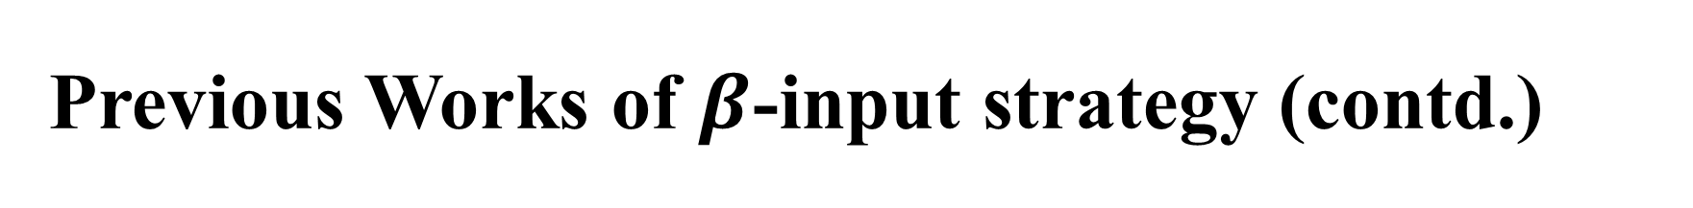
Previous Works of $β$-input strategy (contd.)
2. Multi-Rate VAE
Approach with hypernetwork methodology
Analysis mainly with RD-curve
Bae, Juhan, et al. "Multi-Rate VAE: Train Once, Get the Full Rate-Distortion Curve." The Eleventh International Conference on Learning Representations. 2023.

Slide 25
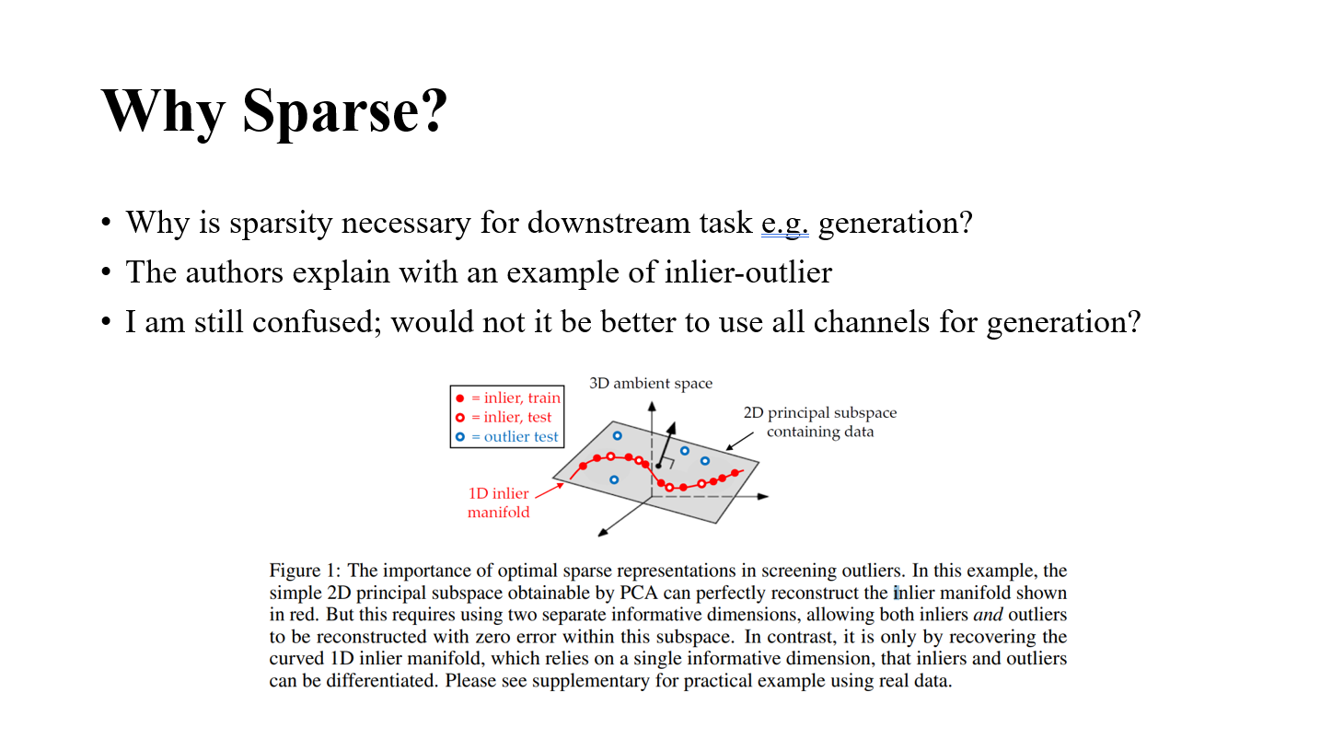
Discussion
Optimal (minimal) sparse representation is necessary for generation?
Conversely, is not a maximal dense representation (bounded by latent dimension)
Required empirically?
While the authors’ argument makes intuitive sense,
It conflicts with my previous understanding of generation…

Slide 26
Thank you for listening
Presenter: Kim Seung Hwan (overnap@khu.ac.kr)

